Slide 1
Foundations of Complex Software Architectures and Styles
Damian A. Tamburri, Ph.D.
damianandrew.tamburri@polimi.it
dtamburri@acm.org

Slide 2
Today we talk Big Data & Data-Intensive Design!
Where does it come from...
Where does it go...
How does it do what it does...
What can we do about it, architecturally!

Slide 3
What is big data?
“Big Data is a collection of very huge data sets with a great diversity” [11]
“Big data should be thought of as a process — how to get to new insights, how to turn them into action, resulting in business value” [Gartner Report 2015]
“Big Data are high-volume, high-velocity, and/or high-variety information assets that require new forms of processing to enable enhanced decision making, insight discovery and process optimization” [Gartner Report 2012]

Slide 4
What is big data?
“Big Data is a collection of very huge data sets with a great diversity” [11]
“Big data should be thought of as a process — how to get to new insights, how to turn them into action, resulting in business value” [Gartner Report 2015]
“Big Data are high-volume, high-velocity, and/or high-variety information assets that require new forms of processing to enable enhanced decision making, insight discovery and process optimization” [Gartner Report 2012]
In summary, 3 Vs…

Slide 5
High volume
KB = Kilobyte = 10³
MB = Megabyte = 10⁶
GB = Gigabyte = 10⁹
TB = Terabyte = 10¹²
PB = Petabyte = 10¹⁵
EB = Exabyte = 10¹⁸
ZB = Zettabyte = 10²¹
YB = Yottabyte = 10²⁴
Traditional approaches
Big data

Slide 6
High velocity
from persistent data to be queried on demand
to transient data to be consumed on the fly
window/portion
Dynamic System
Registered Continuous Query
input streams
streams of answer

Slide 7
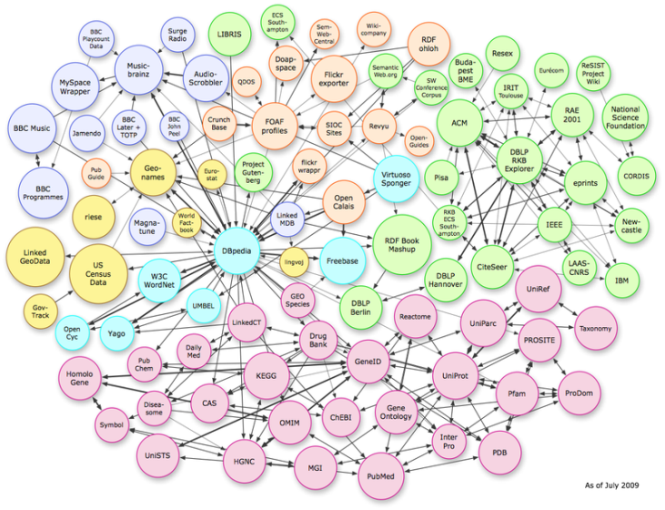
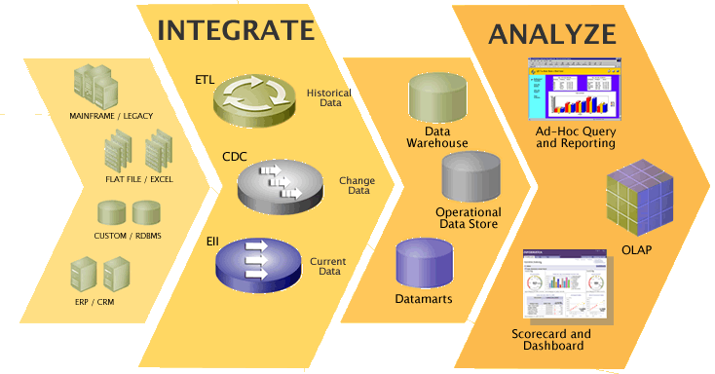
High variety
Heterogeneity/mobility
Incompleteness/uncertainty

Slide 8
The steps of big data processing
Data recording
Data Cleaning/ Integration/ Representation
Data Analysis
Data Visualization/Interpretation
Decision Making

Slide 9

The Rise of Big Data
Software market rapidly shifting to Big data
Expected 32% compound annual growth rate in EU through 2016
Just 35% of Big data projects are successful [10]

Slide 10
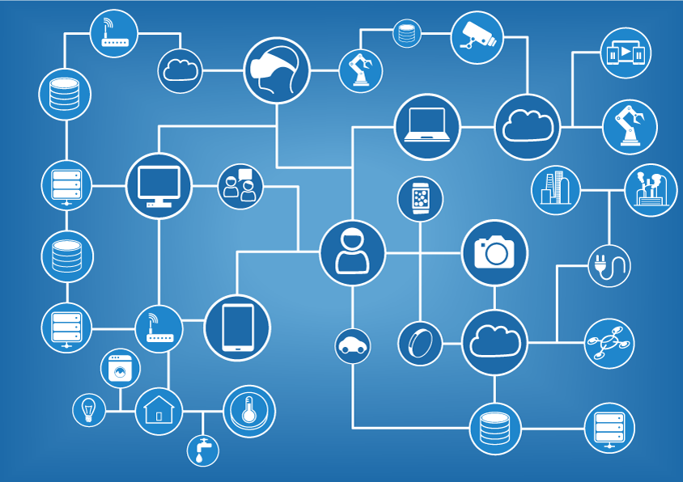
Application Domains
Predictive Analytics
Environmental Monitoring
Science & HPC
E-Government
Media & news
Smart cities
Smart manufacturing
Healthcare
Real-time finance
Advertising
Fraud detection
Maritime operations
…*
*And Counting!

Slide 11
Data Intensive Application (DIA)
A software system that:
Creates…
Records…
Analyses…
Transforms…
Visualises…
... Big Data!

Slide 12
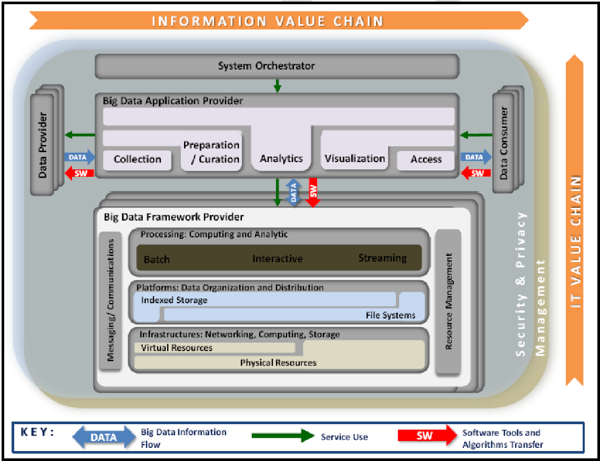
NIST Data-Intensive Reference Architecture

Slide 13







Building blocks for DIAs today
Distributed storage
…
…
…
HDFS
Data streaming
Distributed computation
Cloud infrastructure

Slide 14
Batch vs streaming processing
Batch [webster dictionary]
A quantity of things/persons considered as a group
An amount of something that is made at one time
Stream [webster dictionary]
A continuous flow of people or things
Any flow of liquid or gas
Batch processing
Works on batches of data that are retrieved from some data storage technique
Generates another batch of data
The batch processor terminates when the batch has been processed
Stream processing
Works on continuous flowing data focusing on each single data item
Outputs a new stream of data
The stream processor is still alive after the processing of a data item

Slide 15
Batch
Stream
Computes a function of one data element, or a smallish window of recent data
Computes something relatively simple
Needs to complete each computation in near-real-time – probably seconds at most
Computations are generally independent
Asynchronous – source of data doesn’t interact with the stream processing directly, like by waiting for an answer
Has access to all data
Might compute something big and complex
Is generally more concerned with throughput than latency of individual components of the computation
Has latency measured in minutes or more
http://softwareengineeringdaily.com/2015/08/03/batch-vs-streaming-the-differences/

Slide 16
An example of batch approach - MapReduce
(a, 2)
(a, 1)
(a, 1)
(a, 1)
Reduce₁
(a, 2)
(s, 1)
(d, 2)
(g, 1)
(s, 1)
(g, 1)
(a, 1)
(a, 5)
doc1, a s d a g d
Map₁
(s, 1)
(s, 1)
(s, 2)
doc2, s g a
Reduce₂
(s, 4)
(d, 6)
(d, 2)
(d, 2)
(d, 2)
(d, 2)
(g, 1)
(r, 1)
(a, 1)
(d, 2)
(s, 2)
(g, 1)
(a, 1)
doc3, d d g r a
Map₂
(g, 1)
(g, 1)
(g, 1)
(g, 1)
doc4, d s s g d a
Reduce₃
(g, 4)
(r, 1)
(r, 1)
Notes:
Batch processing is the execution of a series of jobs in a program on a computer without manual intervention (non-interactive). Strictly speaking, it is a processing mode: the execution of a series of programs each on a set or "batch" of inputs, rather than a single input (which would instead be a custom job). However, this distinction has largely been lost, and the series of steps in a batch process are often called a "job" or "batch job".
Divide-et-impera to its best.

Slide 17


Example of stream approach – Apache Storm
Spout:
Source of stream
Emits tuples
Twits from Italy
Twits about soccer
Twits about world cup
Bolt:
Receives tuples
Performs computation
Optionally, emits tuples
Twits about politics
Twits about soccer
Twits from Austria
Twits about Brexit
Twits about politics
Notes:
Stream processing is a computer programming paradigm, equivalent to dataflow programming and reactive programming,^{[1]} that allows some applications to more easily exploit a limited form of parallel processing. Such applications can use multiple computational units, such as the FPUs on a GPU or field programmable gate arrays (FPGAs),^{[2]} without explicitly managing allocation, synchronization, or communication among those units.

Slide 18
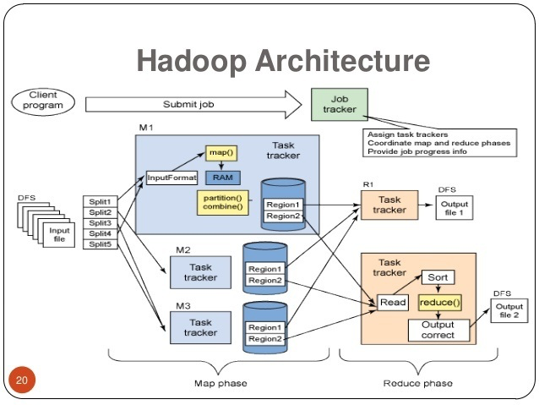
A runtime view on Hadoop MapReduce

Slide 19
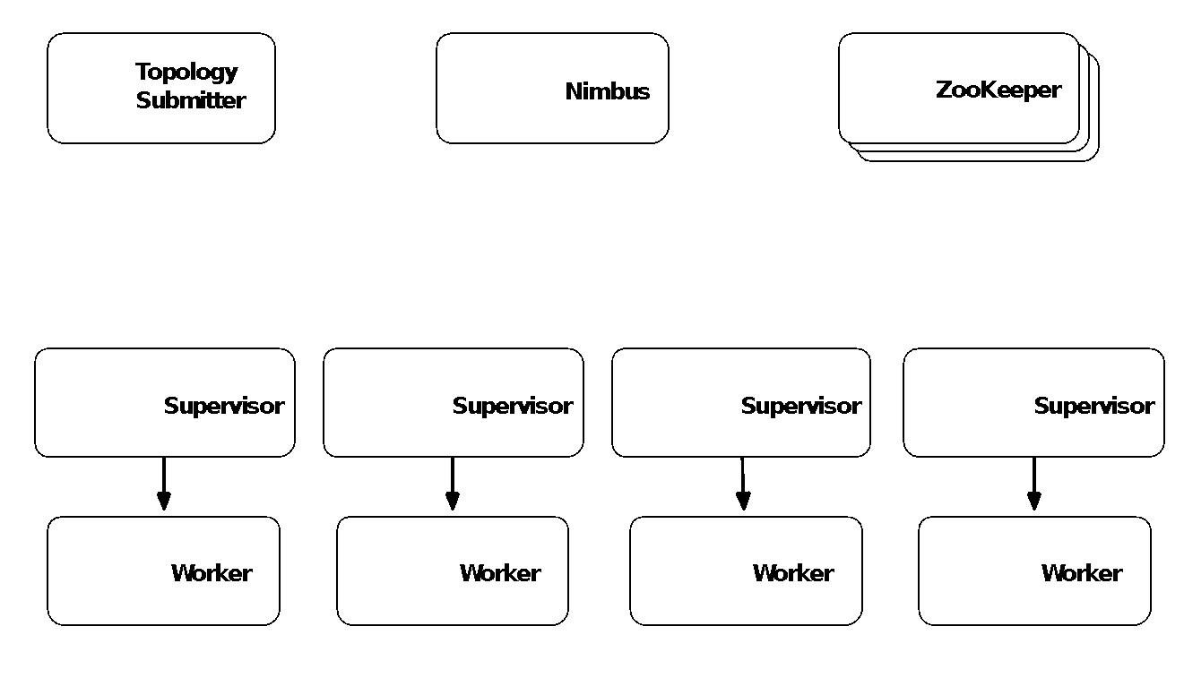
A runtime view on Apache Storm
Submits the topology to Nimbus
Calculates the assignments and sends to ZooKeeper
Sends assignments to Supervisors that download topology from Numbus
Supervisors run workers that execute spouts and bolts

Slide 20
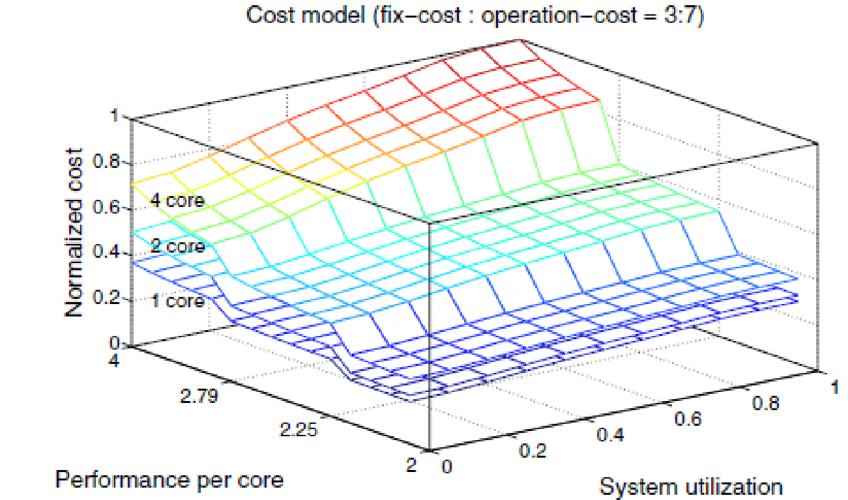
DIA needs for quality
Reliability
Efficiency
Correctness
Availability
Fault-tolerance
Performance
Costs
Privacy
Verification metrics
Anomaly detection metrics

Slide 21

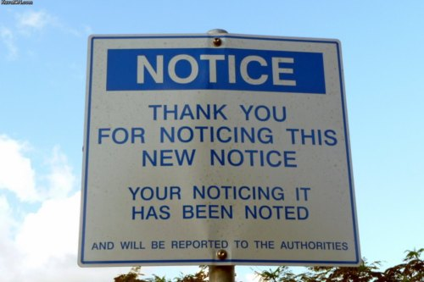
Bored yet?
10 min Break?

Slide 22
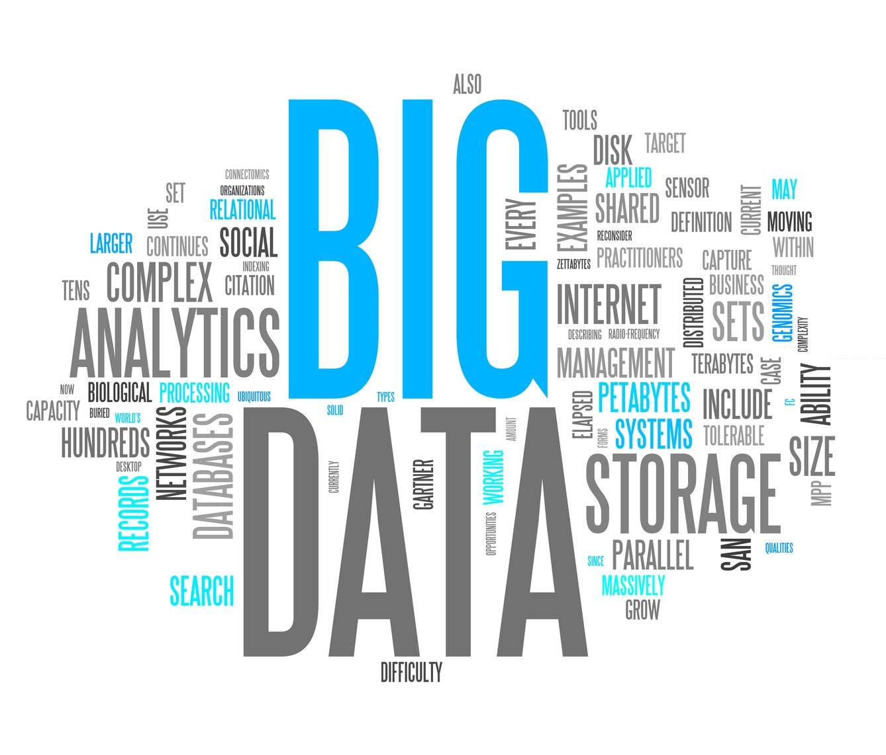

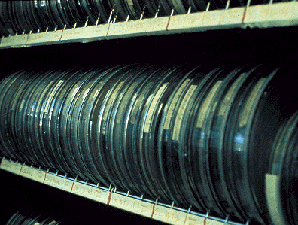




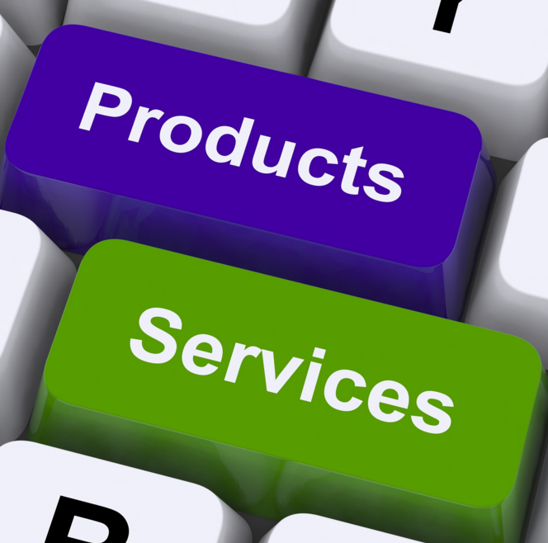
DIA Technology Challenges
Big Data Analytics Adoption
Big Data
(+ others…)
Learning curves
Initial prototype
Risk of failure

Slide 23
Who came to it first?
Take a guess...

Slide 24
Who came to it first?
Take a guess...
I’m an extremely big player in IT

Slide 25
Who came to it first?
Take a guess...
I’m an extremely big player in IT
I have access to humongous amounts of data of every second, minute, hour of everybody’s personal and professional life

Slide 26
Who came to it first?
Take a guess...
I’m an extremely big player in IT
I have access to humongous amounts of data of every second, minute, hour of everybody’s personal and professional life
I know *you* better than you know yourself…

Slide 27

Who came to it first?
Take a guess...
I’m an extremely big player in IT
I have access to humongous amounts of data of every second, minute, hour of everybody’s personal and professional life
I know *you* better than you know yourself…
!!!!

Slide 28
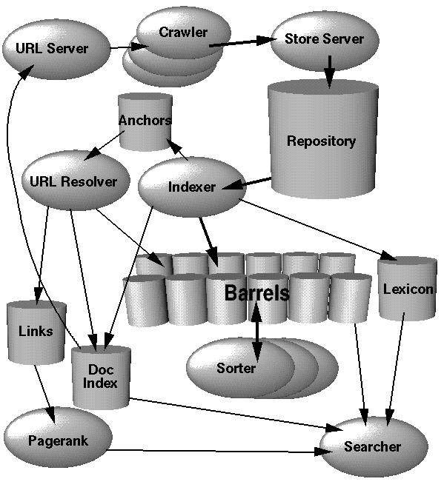
Google search engine architecture
http://infolab.stanford.edu/~backrub/google.html

Slide 29

Google’s search facility
Problem: manipulate huge quantities of data
Approach:
Replicate processing and data storage
Build the network functionality in software
Solutions:
Google distributed file system (GFS)
Typically large files, failure expected and handled
MapReduce
Data selection and reduction
Parallelization done automatically
Software defined networking
OpenFlow manages the internal data center network
Notes:
29

Slide 30
Google’s search facility
Problem: manipulate huge quantities of data
Approach:
Replicate processing and data storage
Build the network functionality in software
Solutions:
Google distributed file system (GFS)
Typically large files, failure expected and handled
MapReduce
Data selection and reduction
Parallelization done automatically
Software defined networking
OpenFlow manages the internal data center network
Notes:
30

Slide 31
Google’s search facility
Problem: manipulate huge quantities of data
Approach:
Replicate processing and data storage
Build the network functionality in software
Solutions:
Google distributed file system (GFS)
Typically large files, failure expected and handled
MapReduce
Data selection and reduction
Parallelization done automatically
Software defined networking
OpenFlow manages the internal data center network
First of its kind
NoSQL DB!
Notes:
31

Slide 32
Google’s search facility
Problem: manipulate huge quantities of data
Approach:
Replicate processing and data storage
Build the network functionality in software
Solutions:
Google distributed file system (GFS)
Typically large files, failure expected and handled
MapReduce
Data selection and reduction
Parallelization done automatically
Software defined networking
OpenFlow manages the internal data center network
First of its kind
NoSQL DB!
First of its kind
Data-Intesive App!
Notes:
32

Slide 33
Google’s search facility
Problem: manipulate huge quantities of data
Approach:
Replicate processing and data storage
Build the network functionality in software
Solutions:
Google distributed file system (GFS)
Typically large files, failure expected and handled
MapReduce
Data selection and reduction
Parallelization done automatically
Software defined networking
OpenFlow manages the internal data center network
First of its kind
NoSQL DB!
First of its kind
Data-Intesive App!
First of its kind
Network-Function Virtualization Architecture
Notes:
33

Slide 34
Google File System (GFS)
Requirements
Storage is distributed and offered by faulty hw
Stored files are large and not numerous
Two kinds of read operations: large streaming reads, small random reads
Large sequential writes to append info to a file
Multiple clients can concurrently append to a file
Data mainly processed in bulk at a high rate

Slide 35
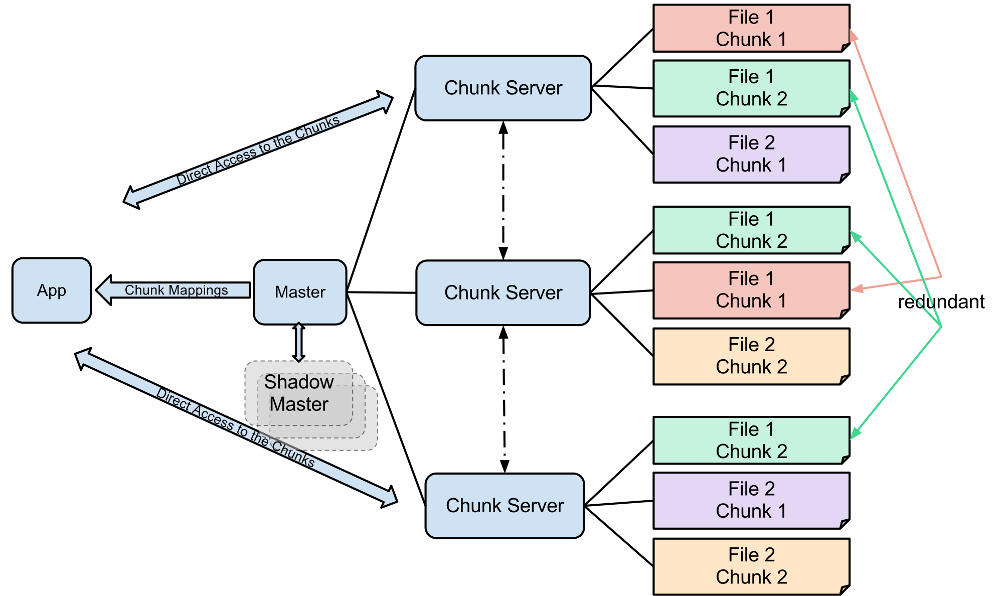
Google File System (GFS)
Logically follows the Map-Reduce paradigm
Redundancy key to availability and speed
Disk accesses are slower than memory operations
Parallelize disk accesses
Notes:
35

Slide 36
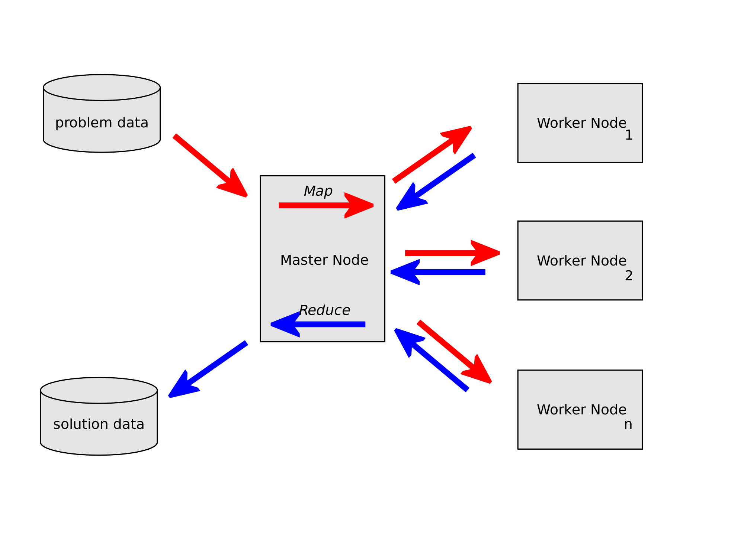

Google’s Map-Reduce
GFS
Notes:
36

Slide 37
Google’s Map-Reduce
Map
The master node takes as input a problem description (e.g., a query), and splits it up in smaller chunks
E.g., an AND query is split in its atomic elements
The smaller chunks are distributed to worker nodes, which compute the answer and return it back to the master node
Reduce
The answers from the worker nodes are combined
E.g., for an AND query compute the intersection of the query results
The results need to be presented at the same time, or the reduction function be associative
Notes:
37

Slide 38
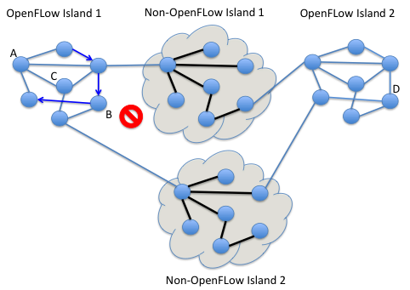
Google software-defined networking
Traditional architectures
Routing intelligence is distributed
Network devices take routing decisions based on local knowledge within proprietary switches
OpenFlow
Separation of routing control from forwarding
Routing decisions are taken with global knowledge outside switches
The physical network can be logically sliced
Routing logic is quickly and ad-hoc deployed
May lead to almost 100% bandwidth utilization
Applicable only under the same administrative domain
Notes:
38

Slide 39
Data-Intensive Architectural lessons from Google
Abstraction layers abound
MapReduce hides the intricacies of parallelizing operations
GFS hides details of data distribution and failure
OpenFlow papers an overlay network atop the physical one
Designing from the outset for living with failure
Of processing, storage, and network elements
Scale is everything
Google’s business demands that everything be built with scaling issues in mind
Solutions are specially designed to the problem domain
Rather than taking the generic “industry standard” approach
Notes:
39

Slide 40
As it turns out...
Google is not the only one, just the first one...

Slide 41
Guess...
Who was next?

Slide 42
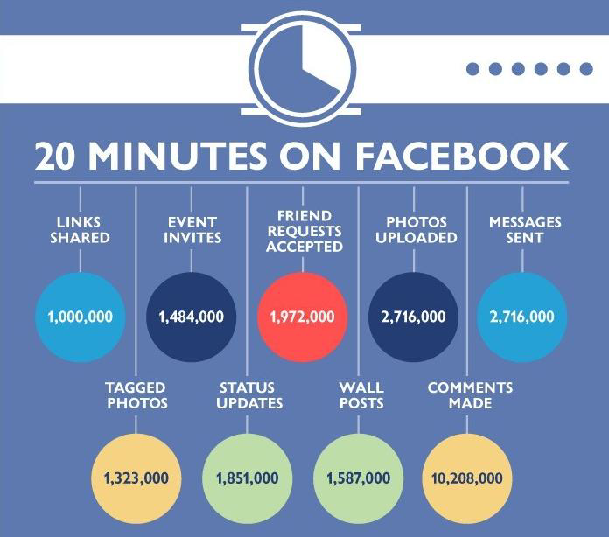

Slide 43
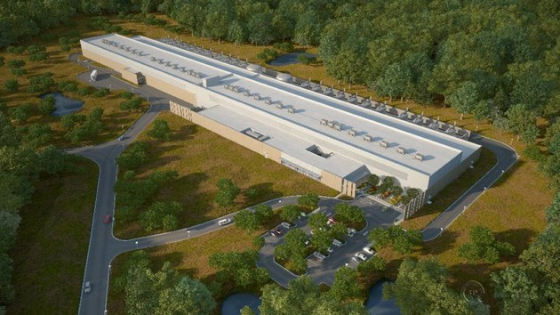

Facebook’s infrastructure
Connects its 500 million users using an array of open source software
Facebook's open source Web serving infrastructure based on LAMP
Linux/Apache/MySQL/PHP
Facebook’s 450 MLN $ North Carolina data center
http://www.facebook.com/Engineering
Notes:
PHP is a general-purpose server-side scripting language originally designed for Web development to produce dynamic Web pages. It is one of the first developed server-side scripting languages to be embedded into an HTML source document rather than calling an external file to process data. The code is interpreted by a Web server with a PHP processor module which generates the resulting Web page.
HipHop for PHP is a source code transformer for PHP script code. HipHop programmatically transforms PHP source code into C++ and then uses g++ to compile it to machine code. HipHop includes a code transformer, a reimplementation of PHP's runtime system, and a rewrite of many common PHP Extensions to take advantage of these performance optimizations.

Slide 44
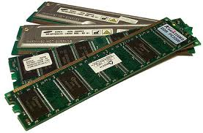
Facebook data store: three tier architecture
Web Server (Apache)
300M
request
memcache
5M
request
MySQL
28 TB RAM
http://www.slideshare.net/mozion/facebook-architecture-for-600m-users
Notes:
In computing, memcached is a general-purpose distributed memory caching system that was originally developed by Danga Interactive for LiveJournal, but is now used by many other sites. It is often used to speed up dynamic database-driven websites by caching data and objects in RAM to reduce the number of times an external data source (such as a database or API) must be read. Memcached runs on Unix, Linux, Windows and Mac OS X and is distributed under a permissive free software license.[2]
98% hitrate

Slide 45
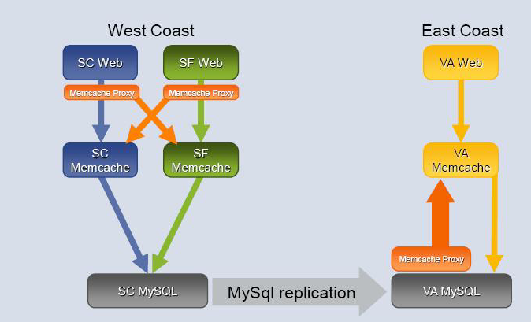
Facebook data store: replication

Slide 46
How many servers are at FB?
Hardware infrastructure is kept confidential
An estimate can be derived from public data on energy consumption
Data centers (DCs) consume as much power as cities
Energy cost reduction is imperative for DCs

Slide 47
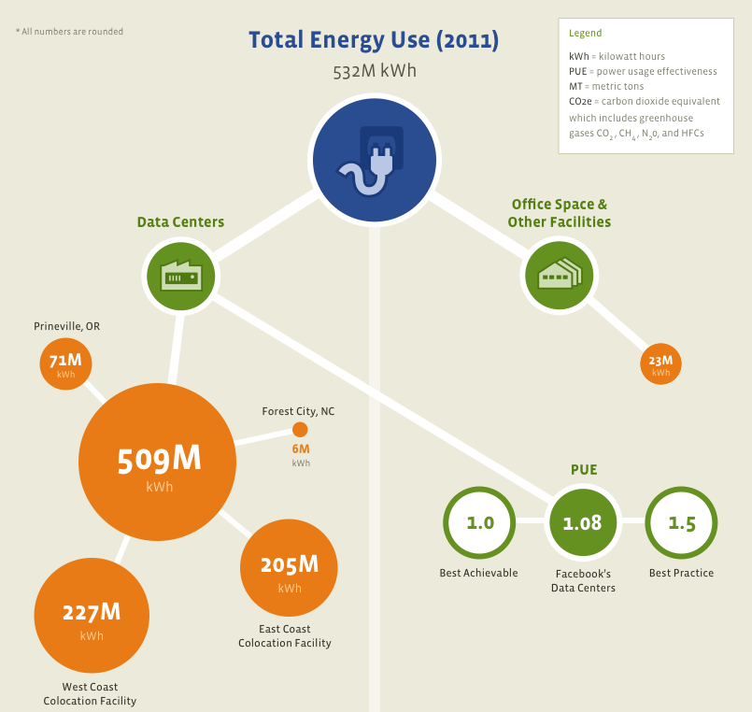
Comparable to the entire city of Turin for 1 year!

Slide 48
Estimating FB servers
FB reports an unbelievably good (1.07-1.08) Power Usage Effectiveness (PUE)
Means that for every Watt delivered to their servers they lose only 0.07-0.08W in power distribution and mechanical systems
Using a PUE number of 1.07, we know they are delivering 54.27MW to the IT load (servers and storage)
We don’t know the average server draw at FB, but they have excellent server designs so they likely average at or below as 300W per server
Hence:
250W/server: 217,080 servers
300W/server: 180,900 servers
350W/server: 155,057 servers
http://perspectives.mvdirona.com/2012/08/13/FunWithEnergyConsumptionData.aspx

Slide 49
A Couple of Architectural Lessons from Facebook
Data-Intensive Architectures
Deployment is everything
Architecting & Deploying for power-efficiency
Power-efficient architectures offer huge savings!

Slide 50
Data-Intensive Architectural Styles

Slide 51
Remember
Data-Intensive Application:
Produces, consumes, visualizes, processes… Big Data!
Uses one (or more) data-intensive middleware to do so
Uses cloud infrastructure
Has Data-intensive architectural style!

Slide 52
Data-Intensive Styles Explained!
Why: purposefully combine data-intensive middleware;
E.g., combine Hadoop for Batch Processing & Spark for stream processing, along with Kafka for message brokering
How: usually following infrastructure automation co-operation & co-occurrence patterns between inter-dependent middleware
E.g., “deploy zookeeper + storm”;
Where: in the cloud, automated deploy using containers

Slide 53
Lambda Architecture
Lambda architecture
Data Source
Coordinator (Kafka)
Data Source
Serving Layer
Serving Layer
Data Store
Serving Layer
Speed Layer
Batch Layer
Orchestrator (Hadoop Cluster)

Slide 54
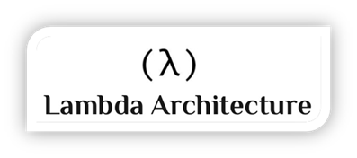
Background of Lambda Architecture
Background
Reference architecture for Big Data systems
Designed by Nathan Marz (Twitter)
Defined as a system that runs arbitrary functions on arbitrary data
“query = function(all data)”
Design Principles
Human fault-tolerant, Immutability, Computable
Lambda Layers
Batch - Contains the immutable, constantly growing master dataset.
Speed - Deals only with new data and compensates for the high latency updates of the serving layer.
Serving - Loads and exposes the combined view of data so that they can be queried.
Notes:
Lambda = architectural pattern to talk about the complexity of dealing with real-time and historical datasets
Overall use
Prescriptive/Predictive uses rely on some dimension of real-time
Use cases
CPG – consumer goods looking at what customers are doing in real-time and making adjustments
Medical – real-time medical sensors and treatment and labs for critical patient care
Financial – credit risk and transaction fraud
Manufacturers – IoT/Telematics getting information from their plants and logistics, cross referencing to inventory, and making adjustments to supply chain

Slide 55
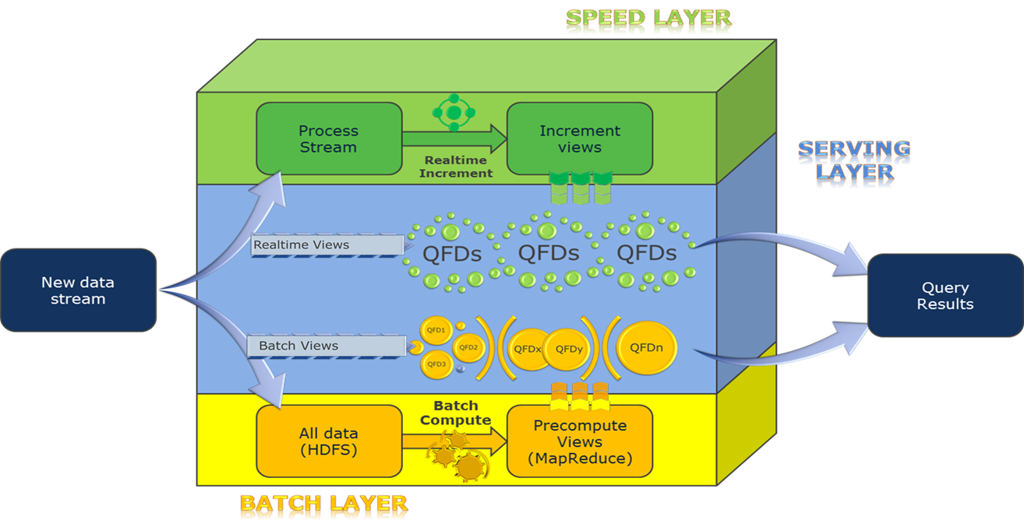
Overview of Lambda Architecture
Notes:
General architecture that covers how Lambda works overall
Able to address real-time and historical data
Layers
Speed – real-time/current data streams; spark, storm, etc.
Batch – historical data layer
Serving – ability to take the current data and historical and merge the results and provide that to the organization
Real-world experience/strategy
Do not tackle all of the data but rather necessary segments of business functionality called queries
Data can be tackled per query hence the idea of “query focused datasets” or qfds
Allows for more focused results/faster speed gains

Slide 56
For Example
A real-time e-health system!

Slide 57
Every year, more than a million people from all 50 states and nearly 150 countries come for care
Challenges in Medical Data
Health data tends to be “wide”, not “deep”
New data types are becoming more important
Unstructured
Real-time streaming
A challenge to generally move from retrospective “BI” viewing to event-based and predictive analytics usage

Slide 58
Optimize an existing Natural Language Processing pipeline in support of critical Surgery
(Move to tens of thousands of documents processed)
Replace an existing free-text search facility used by Clinical Web Service for cancer
(Move search to milliseconds)

Slide 59
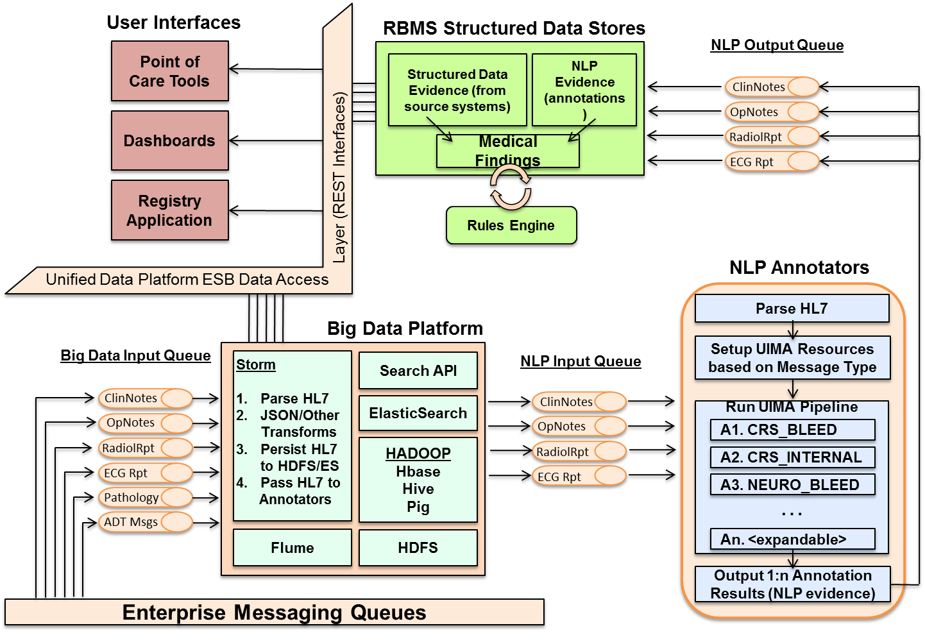
Overall Architecture

Slide 60
Operational Statistics
Current Storm throughput up to 1.5 million documents per hour
Average of 140,000 HL7 messages actually processed per day with average latency of 60 milliseconds from ingest to persistence
Average of 50,000 documents passed through annotators per day versus 5,000 historically
Actual annotations of documents up to 6 times faster than previously accomplished
Free-text search use cases that took over 30 minutes on old infrastructure completing in milliseconds in ElasticSearch
Notes:
HL7 actual processing based on “pull” requests from users not actual processing power
HL7 are large xml-based documents
Much larger than say JSON or others (roughly 800k-900k in size)
Contains significant data related to medical information
End goal
An architecturally-driven, internally-owned technology stack that blends:
An event-based processing fabric
A real-time processing framework
A multi-destination distillation hub
“Classic” BI delivery techniques
“Services-based” delivery techniques
A “serendipitous” discovery environment
Mutually supportive components that combine in delivering novel clinical solutions.

Slide 61
Implementing Lambda
Challenges
Multiple layers
Lots of events, data
Complex
Lots of different languages and data structures
Difficult to maintain
Lots of moving pieces/components/technologies
Lots of changes for the business
Need for Practical Lambda approach
Based on real-world implementations
Metadata model (events and data)
Discrete data (query focused datasets)
Data convergence (holistic query focused dataset)

Slide 62
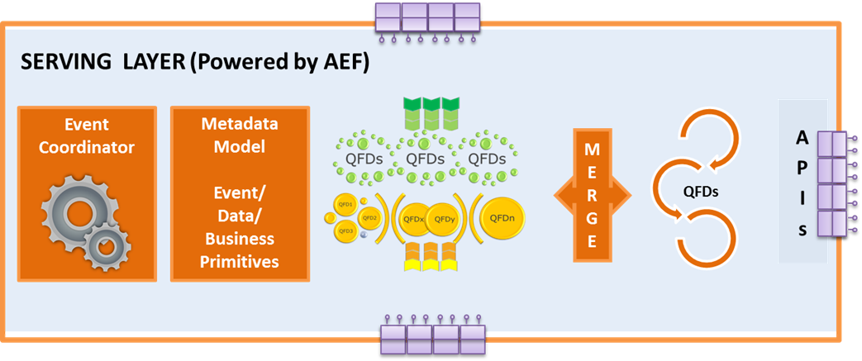
Active Executor Lambda Framework
Notes:
The serving layer coordinates bringing this data together and creating a holistic view of the data
Teradata understands some form of event and corresponding coordination of events to bring the data across the layers to the serving layer
A general metadata model for data lineage and transformations
Merge the data together into a holistic data set so that it can be served to consumers
A context component that allows events, data, and requests to be held together
Rules engine that allows for determinations based on sensing patterns
Workflow/Dataflow for execution of necessary processing on data
Save on the constant re-computation
Snapshotted/versioned data
Calculations done on these versions
Can be worked with varios data structures and Hadoop components
Full re-computation can be deferred and used to verify/replace specific snapshots

Slide 63
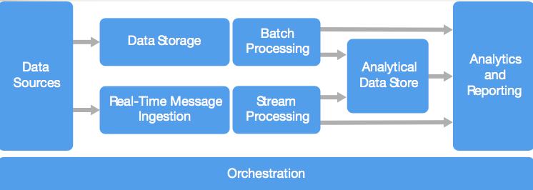
Big Data Logic Style
Born in Microsoft, MSDN field guide
More like a reference architecture than a style
Overly Similar to Lambda
Notes:
https://docs.microsoft.com/en-us/azure/architecture/guide/architecture-styles/big-compute

Slide 64
Big Data Logic Style
Data-Intensive Components
Notes:
https://docs.microsoft.com/en-us/azure/architecture/guide/architecture-styles/big-compute

Slide 65
For Example: Lambda Architecture!
Lambda architecture
Data Source
Coordinator (Kafka)
Data Source
Serving Layer
Serving Layer
Data Store
Serving Layer
Speed Layer
Batch Layer
Orchestrator (Hadoop Cluster)

Slide 66
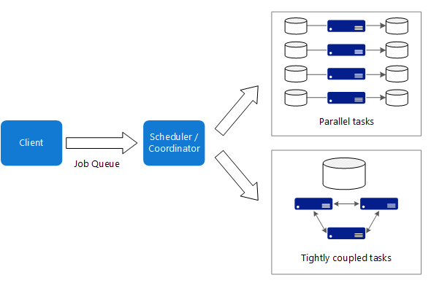
Big Compute Style
Goal: “build a single application computing a huge workload”
Usually via a single data-intensive middleware
Notes:
https://docs.microsoft.com/en-us/azure/architecture/guide/architecture-styles/big-compute

Slide 67
For Example: Hadoop & Yarn!
Apache Hadoop Cluster
Apache Hadoop Client
Apache Yarn, Cluster manager
Notes:
https://docs.microsoft.com/en-us/azure/architecture/guide/architecture-styles/big-compute

Slide 68
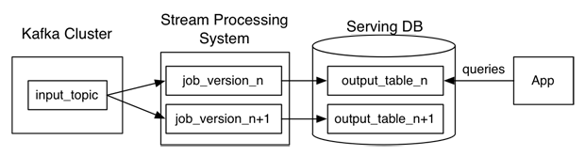
Kappa Architecture
Kappa (implemented)
Everything done in the Streaming (Speed) Layer
Take into accounts the versioning of the application

Slide 69
Kappa Architecture, in Azure, Managed
Stream
Analytics
Azure SQL
Database
...
at date:time, employee E changed
Customer C attributes to {...};
at date:time, employee E changed
Customer C attributes to {...};
at date:time, employee E changed
Customer C attributes to {...};
...
Event Hub
...
at date:time, product P was bought
from supplyer S in quantity Q2 at price P2
with attributes {...} by Employee E;
at date:time, product P was bought
from supplyer S in quantity Q2 at price P2
with attributes {...} by Employee E;
...
...
at date:time, product P was sold
to customer C in quantity Q1 at price P1;
at date:time, product P was sold
to customer C in quantity Q1 at price P1;
at date:time, product P was sold
to customer C in quantity Q1 at price P1;
...
...
at date:time, employee E changed
Customer C attributes to {...};
at date:time, employee E changed
Customer C attributes to {...};
at date:time, employee E changed
Customer C attributes to {...};
...
Immutable
Append-only
Raw data
Materialized Views
Stream Processing System

Slide 70
Kappa Architecture, in Azure, Managed
Pseudo
T-SQL
Immutable Logs
Power BI
Pull mode
API Call
Stream Analytics
Azure SQL Database
Event Hub

Slide 71
Middleware Options: ~300 (+1/month)!!!

Slide 72
Other Architectural Initiatives around Big Data
NIST
EU
Others

Slide 73
NIST Big Data Initiative
Led by Chaitin Baru, Bob Marcus, Wo Chang

Slide 74
NBD-PWG (NIST Big Data Public Working Group) Subgroups & Co-Chairs
There were 5 Subgroups
Note mainly industry
Requirements and Use Cases Sub Group
Geoffrey Fox, Indiana U.; Joe Paiva, VA; Tsegereda Beyene, Cisco
Definitions and Taxonomies SG
Nancy Grady, SAIC; Natasha Balac, SDSC; Eugene Luster, R2AD
Reference Architecture Sub Group
Orit Levin, Microsoft; James Ketner, AT&T; Don Krapohl, Augmented Intelligence
Security and Privacy Sub Group
Arnab Roy, CSA/Fujitsu Nancy Landreville, U. MD Akhil Manchanda, GE
Technology Roadmap Sub Group
Carl Buffington, Vistronix; Dan McClary, Oracle; David Boyd, Data Tactics

Slide 75
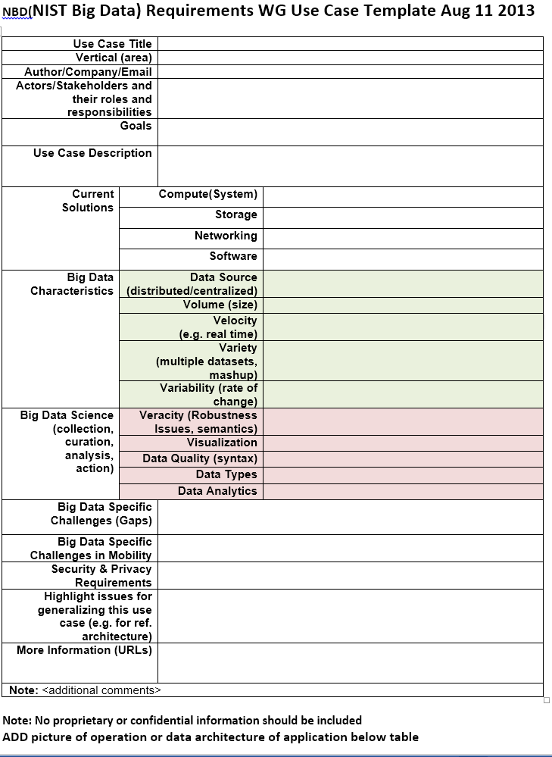
Use Case Template
26 fields completed for 51 areas
Government Operation: 4
Commercial: 8
Defense: 3
Healthcare and Life Sciences: 10
Deep Learning and Social Media: 6
The Ecosystem for Research: 4
Astronomy and Physics: 5
Earth, Environmental and Polar Science: 10
Energy: 1

Slide 76
51 Detailed Use Cases: Contributed July-September 2013 Covers goals, data features such as 3 V’s, software, hardware
Government Operation(4): National Archives and Records Administration, Census Bureau
Commercial(8): Finance in Cloud, Cloud Backup, Mendeley (Citations), Netflix, Web Search, Digital Materials, Cargo shipping (as in UPS)
Defense(3): Sensors, Image surveillance, Situation Assessment
Healthcare and Life Sciences(10): Medical records, Graph and Probabilistic analysis, Pathology, Bioimaging, Genomics, Epidemiology, People Activity models, Biodiversity
Deep Learning and Social Media(6): Driving Car, Geolocate images/cameras, Twitter, Crowd Sourcing, Network Science, NIST benchmark datasets
The Ecosystem for Research(4): Metadata, Collaboration, Language Translation, Light source experiments
Astronomy and Physics(5): Sky Surveys including comparison to simulation, Large Hadron Collider at CERN, Belle Accelerator II in Japan
Earth, Environmental and Polar Science(10): Radar Scattering in Atmosphere, Earthquake, Ocean, Earth Observation, Ice sheet Radar scattering, Earth radar mapping, Climate simulation datasets, Atmospheric turbulence identification, Subsurface Biogeochemistry (microbes to watersheds), AmeriFlux and FLUXNET gas sensors
Energy(1): Smart grid
26 Features for each use case
Biased to science

Slide 77
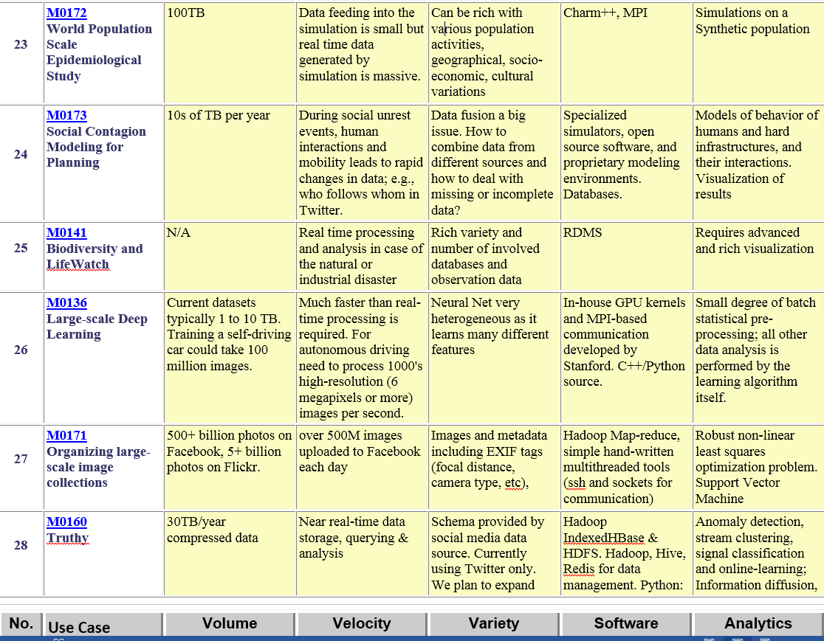
Table 4: Characteristics of 6 Distributed Applications
Application Example | Execution Unit | Communication | Coordination | Execution Environment
Montage | Multiple sequential and parallel executable | Files | Dataflow (DAG) | Dynamic process creation, execution
NEKTAR | Multiple concurrent parallel executables | Stream based | Dataflow | Co-scheduling, data streaming, async. I/O
Replica-Exchange | Multiple seq. and parallel executables | Pub/sub | Dataflow and events | Decoupled coordination and messaging
Climate Prediction (generation) | Multiple seq. & parallel executables | Files and messages | Master-Worker, events | @Home (BOINC)
Climate Prediction (analysis) | Multiple seq. & parallel executables | Files and messages | Dataflow | Dynamics process creation, workflow execution
SCOOP | Multiple Executable | Files and messages | Dataflow | Preemptive scheduling, reservations
Coupled Fusion | Multiple executable | Stream-based | Dataflow | Co-scheduling, data streaming, async I/O

Slide 78
References
See http://bigdatawg.nist.gov/usecases.php
And http://bigdatawg.nist.gov/V1_output_docs.php
http://bigdatawg.nist.gov/usecases.php
https://bigdatacoursespring2014.appspot.com
Fielding, Roy Thomas. "Architectural Styles and e Design of Network-based Software Architectures." PhD diss., , 2000.
Marz, Nathan and Warren, James. Big data: principles and best practices of scalable real-time data systems. : Manning, 2015.
Klöpper, Benjamin, Dix, Marcel, Schorer, Lukas, Ampofo, Ann, Atzmueller, Martin, Arnu, David and Klinkenberg, Ralf. "Defining Software Architectures for Big Data Enabled Operator Support Systems." Paper presented at the meeting of the Proc. IEEE International Conference on Industrial Informatics (INDIN), Boston, MA, USA, 2016.

